Slide 1

GIRFEC Pathway for Planning & Support
- UNIVERSAL
Empowering our clusters guidance
If at any time the child/young person are considered to be at risk of significant harm, existing Child Protection processes and guidance should be followed.
Wellbeing concern continues
Named Person / Key Worker / Class Teacher monitors health and wellbeing
GIRFEC 5 Key Questions
Assess – Plan – Review Cycle
(GIRFMe)
Relevant professionals with child and family
Universal Partnership Approach
Wellbeing concern
Identified
Are additional resources needed?
(GIRFEC 5 Key Questions)
Yes
Request for Additional support
Wellbeing concern improves
No
GIRFEC 5 Key Questions
1. What is getting in the way of this child/young person’s wellbeing?
2. Do I have all the information I need to help this young person?
3. What can I do now to help this child/young person?
4. What can my agency do to help this child/young person?
5. What additional help, if any, may be needed from others?
Tools to support assessment and planning
Child’s network of support
GIRFEC 5 Key Questions
What I think Tool (WITT)
Parent / Carer Views
Pastoral Notes / Chronology
GIRFME Plan
Request for Assistance (RFA)
Colour Key
Universal Pathway
Additional Pathway
Practitioner Guidance

Slide 2




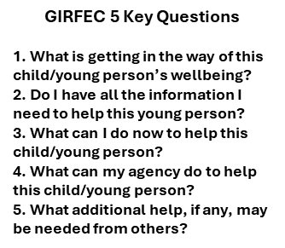




GIRFEC Pathway for Planning & Support
- ADDITIONAL
Wellbeing Planning Meeting
SEEMIS
Wellbeing Plan
Assess – Plan – Review Cycle
Wellbeing concern continues
Cluster Network if Additional supports needed
Move to Intensive support if needed
Possible need for Additional support identified, from within GIRFEC partners or an outside source
Multi-agency professional dialogue process
(GIRFEC 5 Key Questions)
Additional Partnership Approach
Continue planning within Universal supports
Wellbeing needs remain but can be met through Universal support
Tools to support assessment and planning
Outcome Stars
Parent / Carer Views*
Timeline / Chronology*
Wellbeing Information*
My World Triangle*
Action Planning*
CSP*
Request for Assistance (RfA)*
Resilience Matrix
Planning for Children’s Wellbeing
*tool found on SEEMIS Wellbeing App
Additional Pathway
Universal Pathway
Intensive Pathway
Practitioner Guidance

Slide 3



GIRFEC Pathway for Planning & Support - INTENSIVE
Cluster Network – Additions Resources or Specific Pathways where required (examples):
Complex Needs
Child Protection
Looked After Children
Intensive Partnership Approach
Multi-agency Professional Dialogue
Support / Intervention agreed at Wellbeing Meeting
Child’s Plan
Lead Professional agreed
(Plan)
Assess – Plan – Review - Cycle
Move to Additional Level when appropriate
Tools to support assessment and planning
Lead Professional
Child’s views (WITT / OS)
Parent / Carer views
Integrated Assessment
Child’s Plan (can include information from GIRFEme, Wellbeing Plan,CSP, Health Plan)
Resilience Matrix
Intensive Pathway
Additional Pathway
Practitioner Guidance

